Slide 1
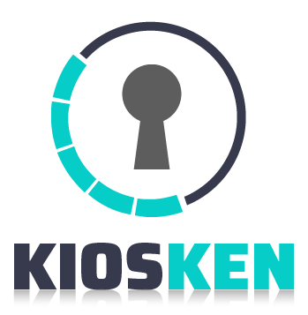
eKiosk
Software License

Slide 2
OVERVIEW
Investing in digital signage is highly beneficial for any organization, whether it is in the retail and functionality features to make sure yours comes with to make sure you get the most out of the package.

Slide 3
01
Easy to Use Software
Above all else, digital displays should be easy to set up use. One great thing about this feature is that it makes it so that multiple stakeholders in your organization can effortlessly learn how to update the displays.
03
Multi-User Access
FEATURES
To make your company’s digital signage easier to update and use
02
Scheduling Content From Anywhere
04
Multi-Layout Display
It is beneficial if the people responsible for updating the display content can update it from anywhere. This is particularly beneficial if your organization has multiple locations, and you want the same content on all displays at all locations.
05
Application Integration
In addition to incorporating videos and images in your digital displays, you may also want to integrate specific apps into the display rotation. For example, it can be beneficial to integrate a weather app into the display so that employees periodically see what the weather forecast is like.

Slide 4
THANK YOU

